Slide 1
{
"name": "Kia_K5",
"mass": 1850.0,
"drag": 0.0099999997764825821,
"chassisDimensions": {
"x": 1.6514999866485596,
"y": 0.5,
"z": 3.820000171661377
},
"inertiaBias": 0.0,
"gearRatio": 4.4380002021789551,
"maxSteerAngle": 31.151662826538086,
"toeAngle": 0.019999999552965164,
"maxBrakeTorque": 4800.0,
"brakeBias": 0.699999988079071,
"handbrakeTorque": 1500.0,
"adherentFriction": 0.949999988079071,
"peak": {
"x": 1.5,
"y": 1.2999999523162842
},
"limit": {
"x": 6.0,
"y": 0.97500002384185791
},
"wheelColliderInfoList": [
{
"name": "Wheel_F1L",
"mass": 20.0,
"radius": 0.31999999284744263,
"suspensionDistance": 0.15000000596046448,
"suspensionAnchor": 0.34999999403953552,
"springRate": 80000.0,
"damperRate": 5000.0
},
{
"name": "Wheel_F1R",
"mass": 20.0,
"radius": 0.31999999284744263,
"suspensionDistance": 0.15000000596046448,
"suspensionAnchor": 0.34999999403953552,
"springRate": 80000.0,
"damperRate": 5000.0
},
{
"name": "Wheel_R1L",
"mass": 20.0,
"radius": 0.31999999284744263,
"suspensionDistance": 0.15000000596046448,
"suspensionAnchor": 0.34999999403953552,
"springRate": 80000.0,
"damperRate": 5000.0
},
{
"name": "Wheel_R1R",
"mass": 20.0,
"radius": 0.31999999284744263,
"suspensionDistance": 0.15000000596046448,
"suspensionAnchor": 0.34999999403953552,
"springRate": 80000.0,
"damperRate": 5000.0
}
],
"idleRpm": 750.0,
"peakRpm": 4500.0,
"maxRpm": 8000.0,
"idleRpmTorque": 160.0,
"peakRpmTorque": 265.0,
"idleRpmCurveBias": 1.0,
"peakRpmCurveBias": 1.0,
"inertia": 0.5,
"frictionTorque": 20.0,
"rotationalFriction": 0.10000000149011612,
"viscousFriction": 0.0099999997764825821,
"torqueCap": true,
"torqueCapLimit": 235.0,
"rpmLimiter": true,
"rpmLimiterMax": 6000.0,
"rpmLimiterCutoffTime": 0.075000002980232239,
"maxIdleThrottle": 1.0,
"activeIdleRange": 0.89499998092651367,
"activeIdleBias": 0.25,
"forwardGearRatios": [
3.8670001029968262,
2.2170000076293945,
1.3710000514984131,
0.93000000715255737,
0.84899997711181641,
0.76700001955032349
]
}

Slide 2
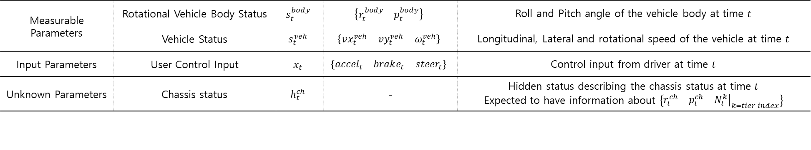
Measurable Parameters | Rotational Vehicle Body Status | $$s_{t}^{body}$$ | $$\left\{\begin{matrix}r_{t}^{body} & p_{t}^{body}\end{matrix}\right\}$$ | Roll and Pitch angle of the vehicle body at time $t$
 | Vehicle Status | $$s_{t}^{veh}$$ | $$\left\{\begin{matrix}vx_{t}^{veh} & vy_{t}^{veh} & ω_{t}^{veh}\end{matrix}\right\}$$ | Longitudinal, Lateral and rotational speed of the vehicle at time $t$
Input Parameters | User Control Input | $$x_{t}$$ | $$\left\{\begin{matrix}accel_{t} & brake_{t} & steer_{t}\end{matrix}\right\}$$ | Control input from driver at time $t$
Unknown Parameters | Chassis status | $$h_{t}^{ch}$$ | - | Hidden status describing the chassis status at time $t$ Expected to have information about $\left\{\begin{matrix}r_{t}^{ch} & p_{t}^{ch} & {\left.N_{t}^{k}\right|}_{k=tier index}\end{matrix}\right\}$
GT
Loss
VPP
Foundation Model
Bicycle model
param
Back prop

Slide 3
Pre training
GT
Loss
Foundation Model
Bicycle model
param
Fine tuning
GT
Loss
A
VPP
Psuedo GT = out + A
param
Foundation Model
A
Bicycle model
out
Loss
Customization model

Slide 4
